Slide 1
Logistic Regression

Slide 2
Logistic Regression
Hypothesis representation
Cost function
Logistic regression with gradient descent
Regularization
Multi-class classification

Slide 3
Logistic Regression
Hypothesis representation
Cost function
Logistic regression with gradient descent
Regularization
Multi-class classification

Slide 4


1 (Yes)
Malignant?
Threshold classifier output $h_{θ}\left(x\right)$ at 0.5
If $h_{θ}\left(x\right)≥0.5,$ predict “$y=1$”
If $h_{θ}\left(x\right)<0.5$, predict “$y=0$”
0 (No)
Tumor Size
$$h_{θ}\left(x\right)=θ^{⊤}x$$

Slide 5
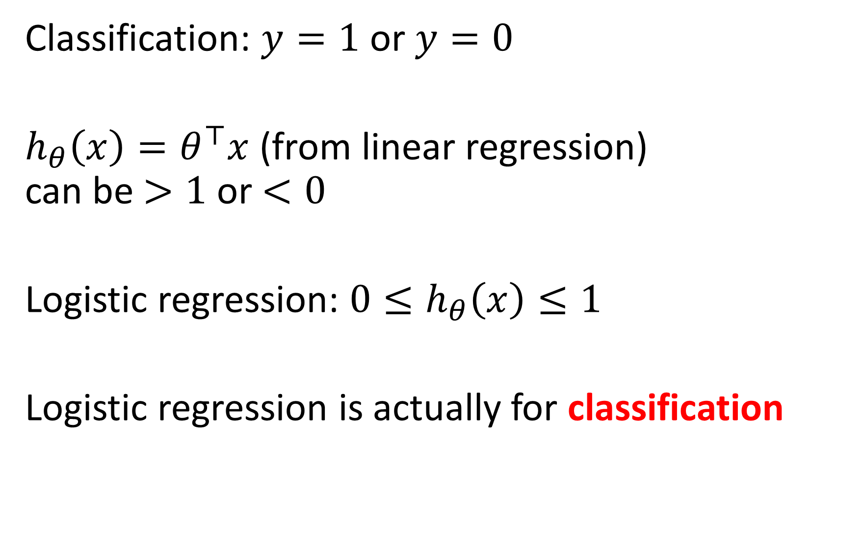
Classification: $y=1$ or $y=0$
$h_{θ}\left(x\right)=θ^{⊤}x$ (from linear regression) can be $>1$ or $<0$
Logistic regression: ${0≤h}_{θ}\left(x\right)≤1$
Logistic regression is actually for classification

Slide 6
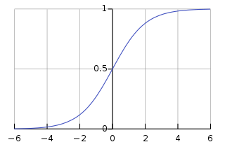
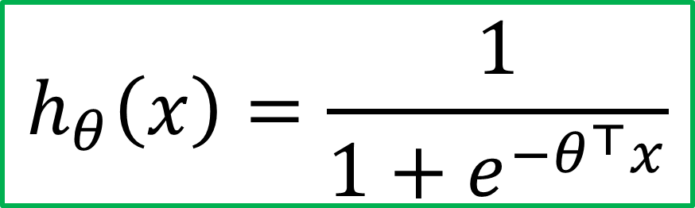
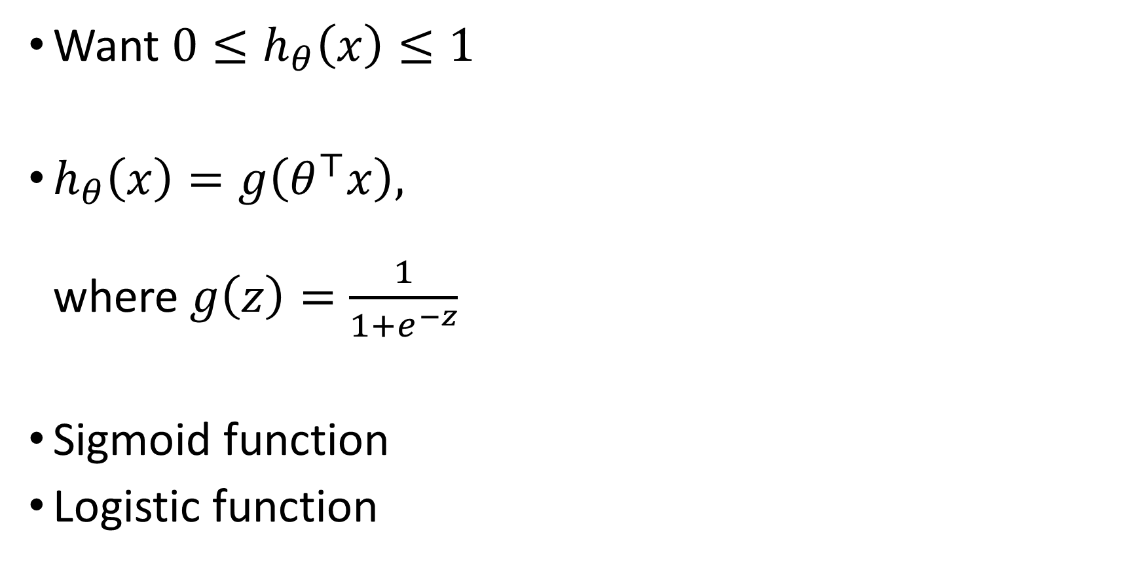


Hypothesis representation
Want ${0≤h}_{θ}\left(x\right)≤1$
$h_{θ}\left(x\right)=g\left(θ^{⊤}x\right),$ where $g\left(z\right)=\frac{1}{1+e^{−z}}$
Sigmoid function
Logistic function
$$h_{θ}\left(x\right)=\frac{1}{1+e^{−θ^{⊤}x}}$$
$$g(z)$$
$$z$$

Slide 7
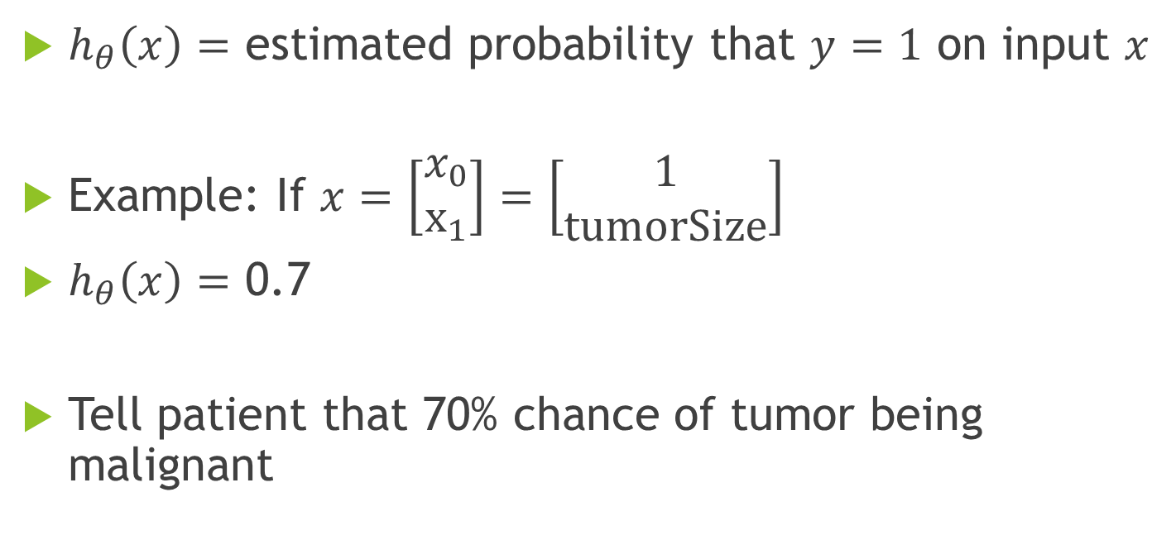
Interpretation of hypothesis output
$h_{θ}\left(x\right)=$ estimated probability that $y=1$ on input $x$
Example: If $x=\left[\begin{aligned}x_{0} \\ x_{1}\end{aligned}\right]=\left[\begin{aligned}1 \\ tumorSize\end{aligned}\right]$
$h_{θ}\left(x\right)=$ 0.7
Tell patient that 70% chance of tumor being malignant

Slide 8
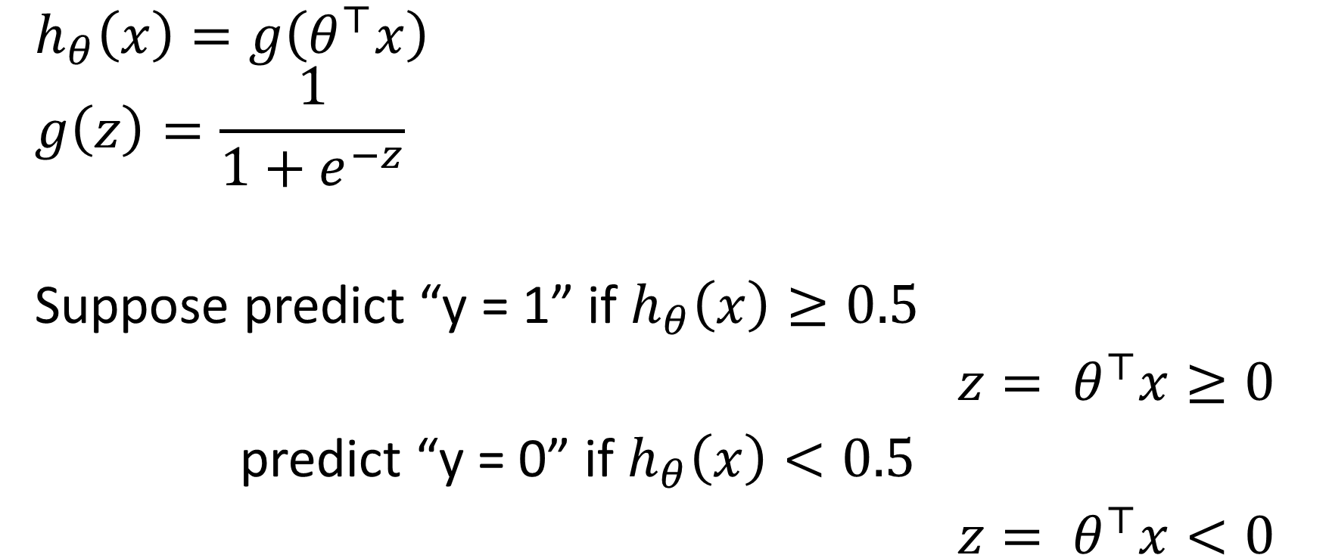


Logistic regression
$$g(z)$$
$$h_{θ}\left(x\right)=g\left(θ^{⊤}x\right)$$
$$g\left(z\right)=\frac{1}{1+e^{−z}}$$
Suppose predict “y = 1” if $h_{θ}\left(x\right)≥0.5$
${z= θ}^{⊤}x≥0$
predict “y = 0” if $h_{θ}\left(x\right)<0.5$
${z= θ}^{⊤}x<0$
$$z=θ^{⊤}x$$

Slide 9
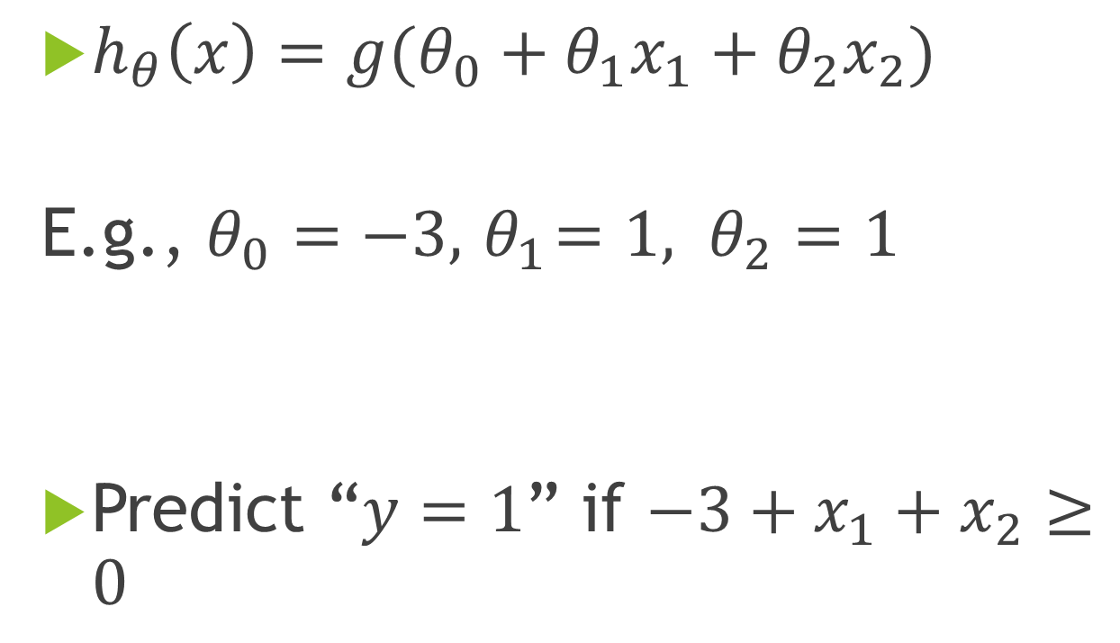
Decision boundary
$h_{θ}\left(x\right)=g(θ_{0}+θ_{1}x_{1}+θ_{2}x_{2})$
E.g., $θ_{0}=−3, { θ}_{1}=1, θ_{2}=1$
Predict “$y=1$” if $−3+x_{1}+x_{2}≥0$
Age
Tumor Size

Slide 10
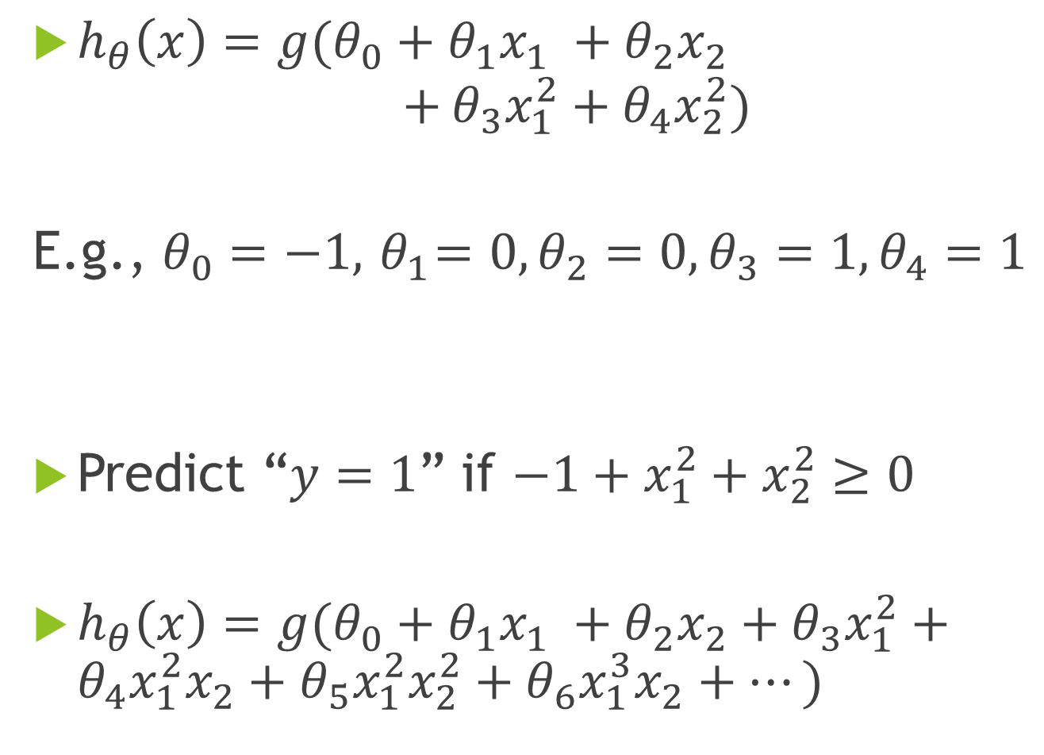
$h_{θ}\left(x\right)=g(θ_{0}+θ_{1}x_{1} +θ_{2}x_{2}$ $+$ $θ_{3}x_{1}^{2}+θ_{4}x_{2}^{2})$
E.g., $θ_{0}=−1, { θ}_{1}=0, θ_{2}=0,θ_{3}=1, θ_{4}=1$
Predict “$y=1$” if $−1+x_{1}^{2}+x_{2}^{2}≥0$
$h_{θ}\left(x\right)=g(θ_{0}+θ_{1}x_{1} +θ_{2}x_{2}+$ $θ_{3}x_{1}^{2}+θ_{4}x_{1}^{2}x_{2}+θ_{5}x_{1}^{2}x_{2}^{2}+θ_{6}x_{1}^{3}x_{2}+⋯)$

Slide 11
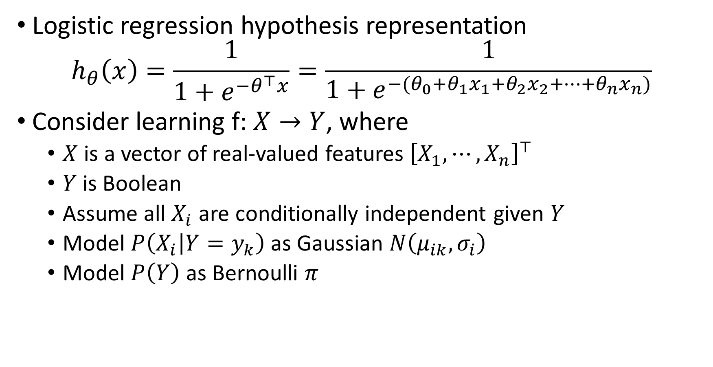

Where does the form come from?
Logistic regression hypothesis representation
$$h_{θ}\left(x\right)=\frac{1}{1+e^{{−θ}^{⊤}x}}=\frac{1}{1+e^{−(θ_{0}+θ_{1}x_{1}+θ_{2}x_{2}+⋯+θ_{n}x_{n})}}$$
Consider learning f: $X→Y$, where
$X$ is a vector of real-valued features ${\left[X_{1}, ⋯,X_{n}\right]}^{⊤}$
$Y$is Boolean
Assume all $X_{i}$ are conditionally independent given $Y$
Model $P\left(X_{i} | Y=y_{k}\right)$ as Gaussian $N\left(μ_{ik}, σ_{i}\right)$
Model $P\left(Y\right)$ as Bernoulli $π$
What is $P\left(Y|X_{1},X_{2}, ⋯,X_{n}\right)$?

Slide 12
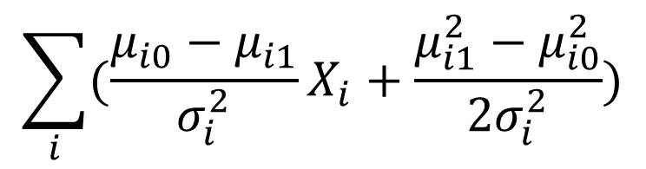
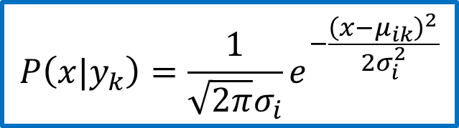



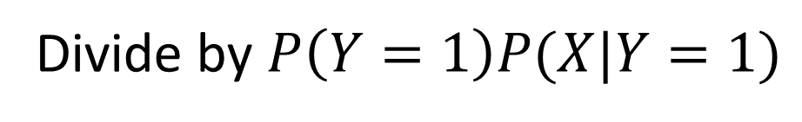
$P\left(Y=1|X\right)=\frac{P\left(Y=1\right)P(X|Y=1)}{P\left(Y=1\right)P(X|Y=1) +P(Y=0)P(X|Y=0)}$
$=\frac{1}{1+\frac{P\left(Y=0\right)P(X|Y=0)}{P\left(Y=1\right)P(X|Y=1)}}$
$= \frac{1}{1+exp(ln⁡(\frac{P\left(Y=0\right)P(X|Y=0)}{P\left(Y=1\right)P(X|Y=1)} ))}$
$=$ $\frac{1}{1+exp(\ln\left(\frac{1−π}{π}\right)+\sum_{i}{ln} \frac{P(X_{i}|Y=0)}{P(X_{i}|Y=1)})}$
$$P\left(Y=1|X_{1},X_{2}, ⋯,X_{n}\right)=\frac{1}{1+exp(θ_{0}+\sum_{i}{θ_{i}}X_{i})}$$
Applying Bayes rule
Divide by $P\left(Y=1\right)P(X|Y=1)$
Apply $exp⁡(ln⁡(⋅))$
Plug in $P(X_{i}|Y)$
$$P\left(x|y_{k}\right)=\frac{1}{\sqrt{2π}σ_{i}}e^{−\frac{{\left(x−μ_{ik}\right)}^{2}}{2σ_{i}^{2}}}$$
$$\sum_{i}{(\frac{μ_{i0}−μ_{i1}}{σ_{i}^{2}}}X_{i}+\frac{μ_{i1}^{2}−μ_{i0}^{2}}{2σ_{i}^{2}})$$

Slide 13
Logistic Regression
Hypothesis representation
Cost function
Logistic regression with gradient descent
Regularization
Multi-class classification

Slide 14
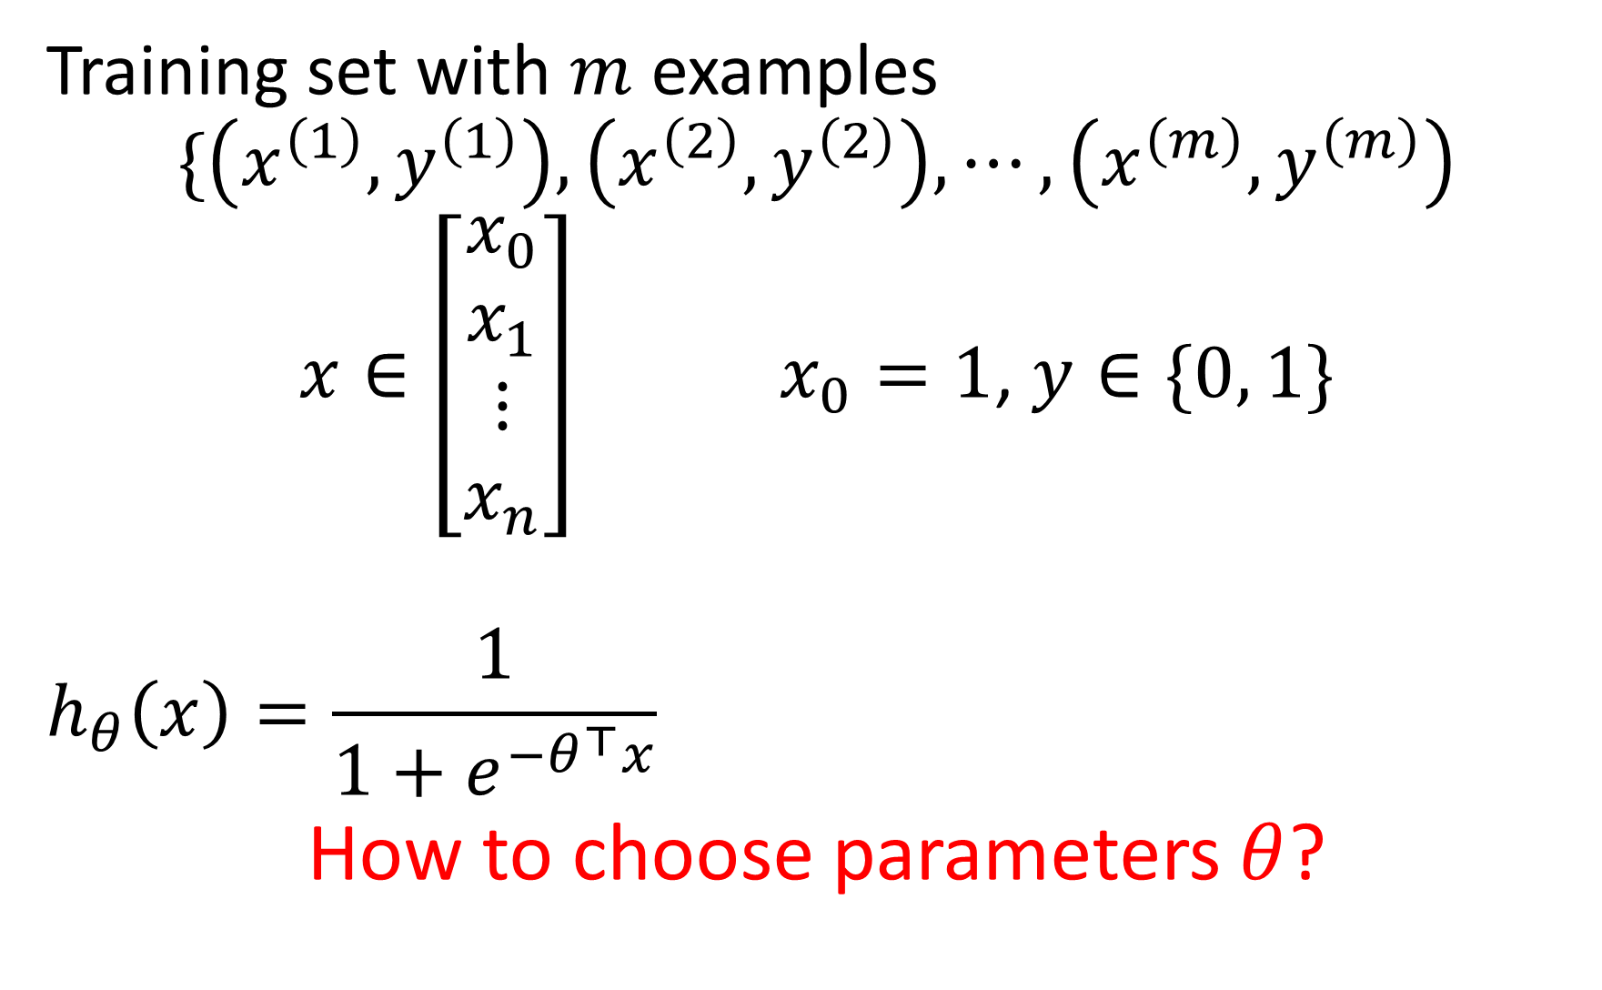
Training set with $m$ examples
$$\{\left(x^{\left(1\right)}, y^{\left(1\right)}\right), \left(x^{\left(2\right)}, y^{\left(2\right)}\right), ⋯,\left(x^{\left(m\right)}, y^{\left(m\right)}\right)$$
$x∈\left[\begin{aligned}x_{0} \\ x_{1} \\ ⋮ \\ x_{n}\end{aligned}\right]$ $x_{0}=1$, $y∈\{0, 1\}$
$$h_{θ}\left(x\right)=\frac{1}{1+e^{−θ^{⊤}x}}$$
How to choose parameters $θ$?

Slide 15
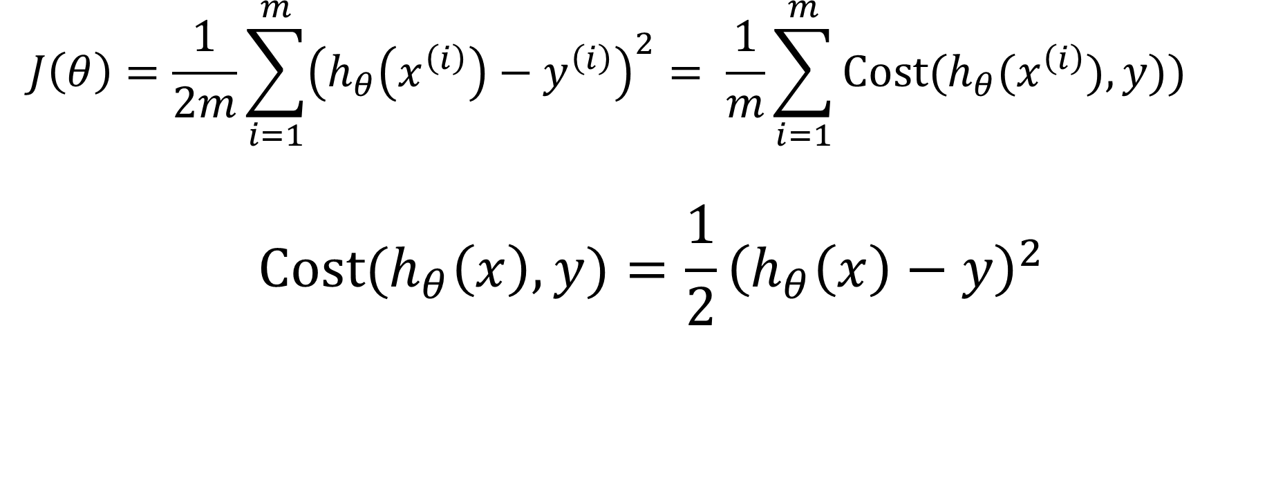
Cost function for Linear Regression
$$J\left(θ\right)=\frac{1}{2m}\sum_{i=1}^{m}{{\left(h_{θ}\left(x^{\left(i\right)}\right)−y^{\left(i\right)}\right)}^{2}}= \frac{1}{m}\sum_{i=1}^{m}{Cost(h_{θ}(x^{\left(i\right)}),y))}$$
$$Cost(h_{θ}\left(x\right),y)=\frac{1}{2}{\left(h_{θ}\left(x\right)−y\right)}^{2}$$

Slide 16



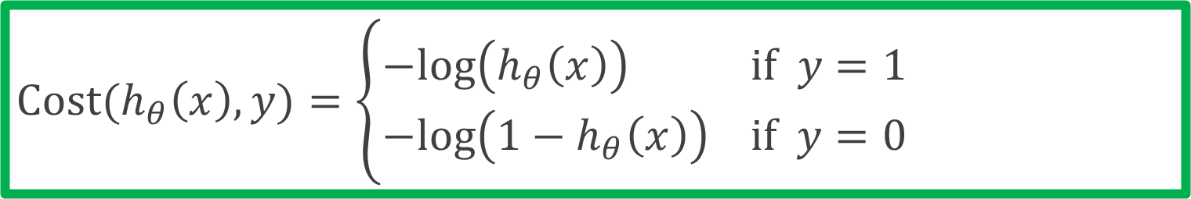





Cost function for Logistic Regression
$$Cost(h_{θ}\left(x\right),y)=\left\{\begin{aligned}−log\left(h_{θ}\left(x\right)\right) if y=1 \\ −log\left({1−h}_{θ}\left(x\right)\right) if y=0\end{aligned}\right.$$
$$if y=1$$
$$if y=0$$
$$0$$
$$h_{θ}\left(x\right)$$
$$1$$
$$0$$
$$h_{θ}\left(x\right)$$
$$1$$

Slide 17
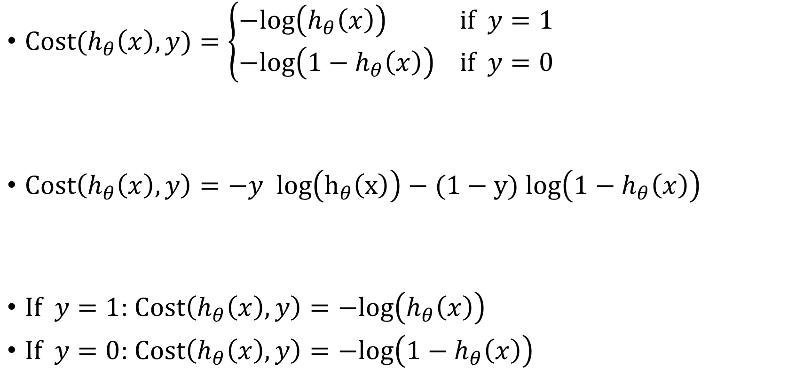
Logistic regression cost function
$Cost(h_{θ}\left(x\right),y)=\left\{\begin{aligned}−log\left(h_{θ}\left(x\right)\right) if y=1 \\ −log\left({1−h}_{θ}\left(x\right)\right) if y=0\end{aligned}\right.$
$Cost\left(h_{θ}\left(x\right),y\right)=−y log\left(h_{θ}\left(x\right)\right)−(1−y)$ $log\left({1−h}_{θ}\left(x\right)\right)$
$If y=1$: $Cost\left(h_{θ}\left(x\right),y\right)=−log\left(h_{θ}\left(x\right)\right)$
$If y=0$: $Cost\left(h_{θ}\left(x\right),y\right)=−log\left({1−h}_{θ}\left(x\right)\right)$

Slide 18
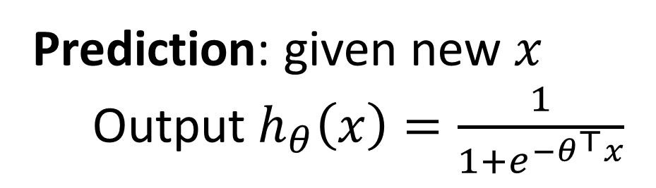

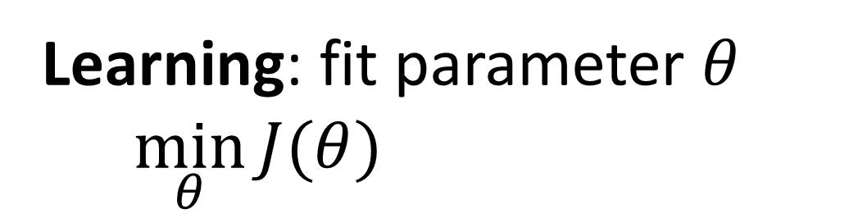
Logistic regression
$$J\left(θ\right)=\frac{1}{m}\sum_{i=1}^{m}{Cost(h_{θ}(x^{\left(i\right)}),y^{(i)}))}$$
$=−\frac{1}{m}\left[\sum_{i=1}^{m}{y^{(i)} log\left(h_{θ}\left(x^{(i)}\right)\right)+(1−y^{(i)}) log\left({1−h}_{θ}\left(x^{(i)}\right)\right)}\right]$
Learning: fit parameter $θ$
$\min_{θ}{J(θ)}$
Prediction: given new $x$
Output $h_{θ}\left(x\right)=\frac{1}{1+e^{−θ^{⊤}x}}$

Slide 19
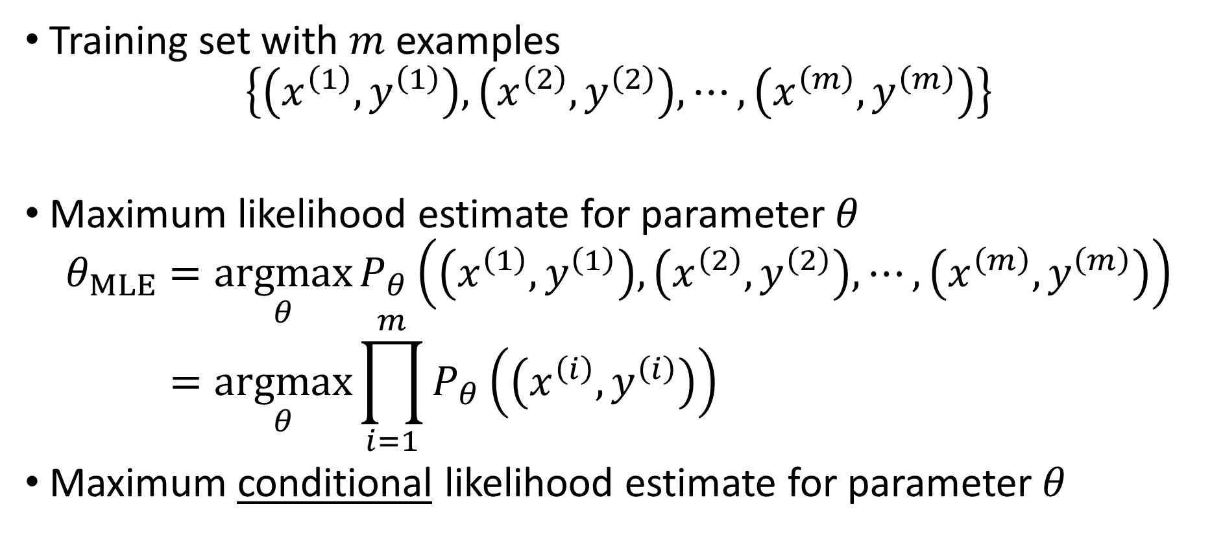
Where does the cost come from?
Training set with $m$ examples
$$\left\{\left(x^{\left(1\right)}, y^{\left(1\right)}\right), \left(x^{\left(2\right)}, y^{\left(2\right)}\right), ⋯,\left(x^{\left(m\right)}, y^{\left(m\right)}\right)\right\}$$
Maximum likelihood estimate for parameter $θ$
$$θ_{MLE}=\underset{θ}{argmax}{P_{θ}\left(\left(x^{\left(1\right)}, y^{\left(1\right)}\right), \left(x^{\left(2\right)}, y^{\left(2\right)}\right), ⋯,\left(x^{\left(m\right)}, y^{\left(m\right)}\right)\right)} \\ =\underset{θ}{argmax}{\prod_{i=1}^{m}{P_{θ}\left(\left(x^{\left(i\right)}, y^{\left(i\right)}\right)\right)}}$$
Maximum conditional likelihood estimate for parameter $θ$

Slide 20

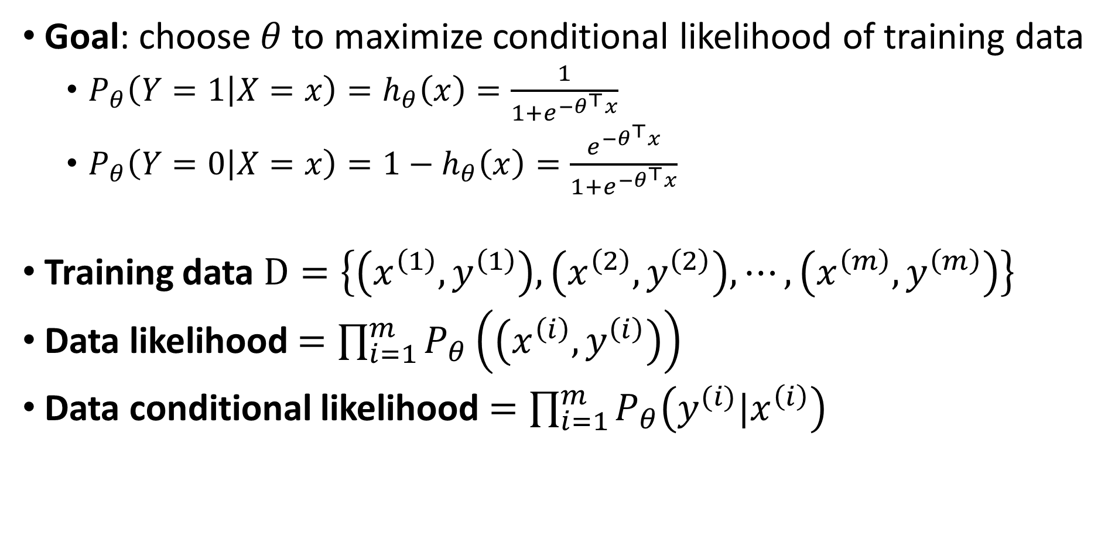
Goal: choose $θ$to maximize conditional likelihood of training data
$P_{θ}\left(Y=1 | X=x\right)=h_{θ}\left(x\right)=\frac{1}{1+e^{{−θ}^{⊤}x}}$
$P_{θ}\left(Y=0 | X=x\right)=1−h_{θ}\left(x\right)=\frac{e^{{−θ}^{⊤}x}}{1+e^{{−θ}^{⊤}x}}$
Training data $D=\left\{\left(x^{\left(1\right)}, y^{\left(1\right)}\right), \left(x^{\left(2\right)}, y^{\left(2\right)}\right), ⋯,\left(x^{\left(m\right)}, y^{\left(m\right)}\right)\right\}$
Data likelihood $=\prod_{i=1}^{m}{P_{θ}\left(\left(x^{\left(i\right)}, y^{\left(i\right)}\right)\right)}$
Data conditional likelihood $=\prod_{i=1}^{m}{P_{θ}\left(y^{(i)}|x^{\left(i\right)}\right)}$
$θ_{MCLE}=\underset{θ}{argmax}$ $\prod_{i=1}^{m}{P_{θ}\left(y^{(i)}|x^{\left(i\right)}\right)}$

Slide 21
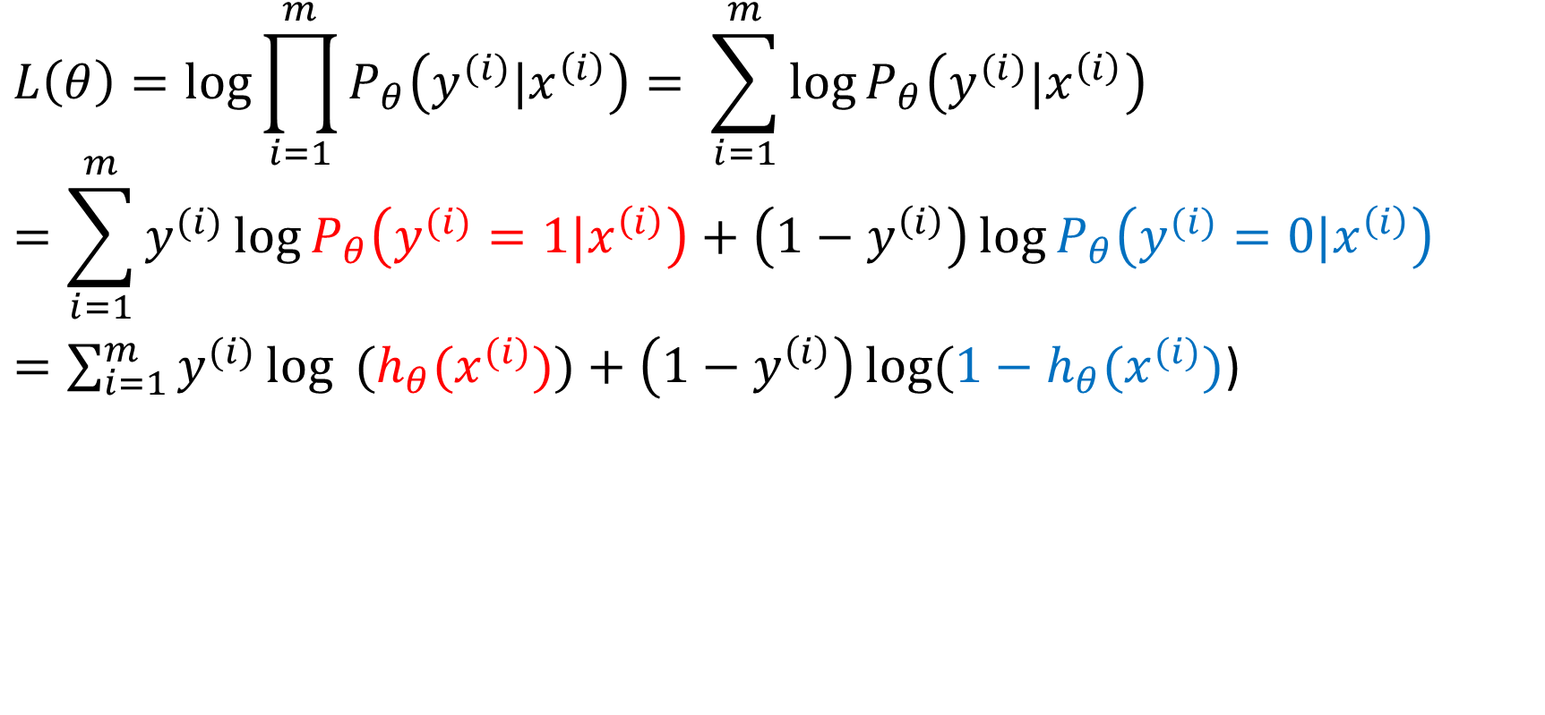
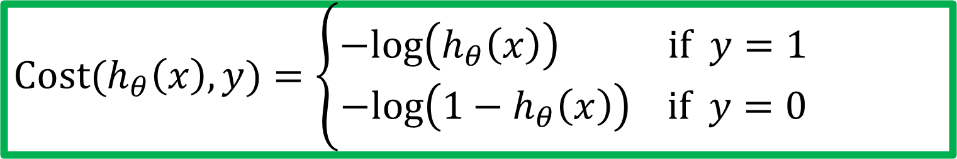
Expressing conditional log-likelihood
$$L\left(θ\right)=\log{\prod_{i=1}^{m}{P_{θ}\left(y^{(i)}|x^{\left(i\right)}\right)}}= \sum_{i=1}^{m}{\log{P_{θ}\left(y^{(i)}|x^{\left(i\right)}\right)}}$$
$$=\sum_{i=1}^{m}{y^{(i)}\log{P_{θ}\left(y^{(i)}=1|x^{\left(i\right)}\right)}}+\left(1−y^{\left(i\right)}\right)\log{P_{θ}\left(y^{(i)}=0|x^{\left(i\right)}\right)}$$
$=\sum_{i=1}^{m}{y^{(i)}\log{ (h_{θ}(x^{(i)})})}+\left(1−y^{\left(i\right)}\right)\log{(1−h_{θ}(x^{(i)})}$)
$$Cost(h_{θ}\left(x\right),y)=\left\{\begin{aligned}−log\left(h_{θ}\left(x\right)\right) if y=1 \\ −log\left({1−h}_{θ}\left(x\right)\right) if y=0\end{aligned}\right.$$

Slide 22
Logistic Regression
Hypothesis representation
Cost function
Logistic regression with gradient descent
Regularization
Multi-class classification

Slide 23
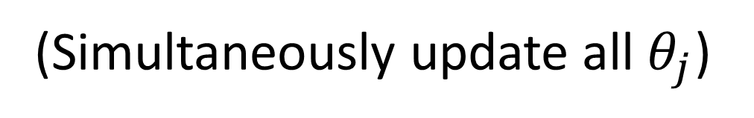

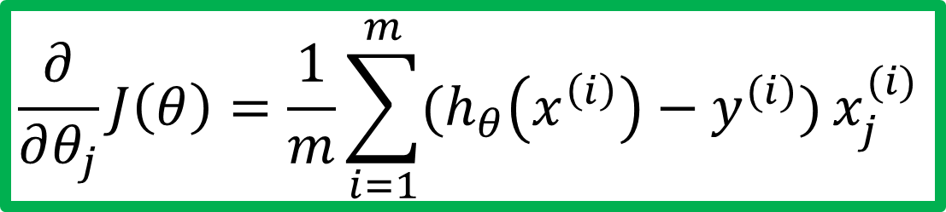
Gradient descent
$$J\left(θ\right)=−\frac{1}{m}\left[\sum_{i=1}^{m}{y^{(i)} log\left(h_{θ}\left(x^{(i)}\right)\right)+(1−y^{(i)}) log\left({1−h}_{θ}\left(x^{(i)}\right)\right)}\right]$$
Goal: $\min_{θ}{J(θ)}$
Repeat {
$$θ_{j}≔θ_{j}−α\frac{∂}{∂θ_{j}}J(θ)$$
}
Good news: Convex function!
Bad news: No analytical solution
(Simultaneously update all $θ_{j}$)
$$\frac{∂}{∂θ_{j}}J\left(θ\right)=\frac{1}{m}\sum_{i=1}^{m}{(h_{θ}\left(x^{\left(i\right)}\right)−y^{(i)})}x_{j}^{(i)}$$

Slide 24
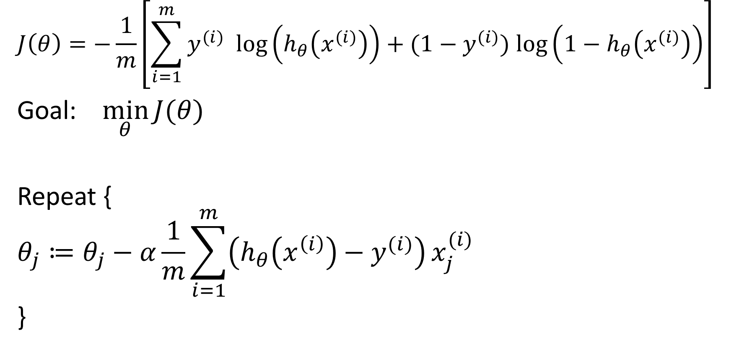
Gradient descent
$$J\left(θ\right)=−\frac{1}{m}\left[\sum_{i=1}^{m}{y^{(i)} log\left(h_{θ}\left(x^{(i)}\right)\right)+(1−y^{(i)}) log\left({1−h}_{θ}\left(x^{(i)}\right)\right)}\right]$$
Goal: $\min_{θ}{J(θ)}$
Repeat {
$$θ_{j}≔θ_{j}−α\frac{1}{m}\sum_{i=1}^{m}{\left(h_{θ}\left(x^{\left(i\right)}\right)−y^{(i)}\right)}x_{j}^{(i)}$$
}
(Simultaneously update all $θ_{j}$)

Slide 25
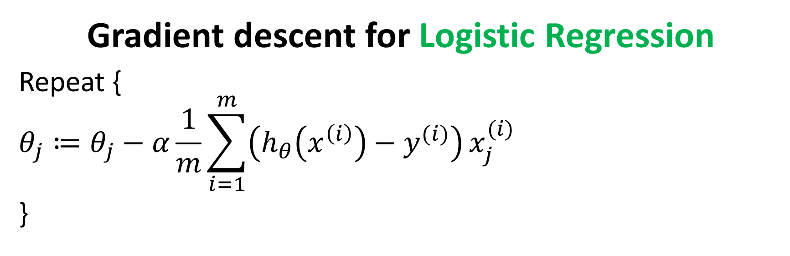
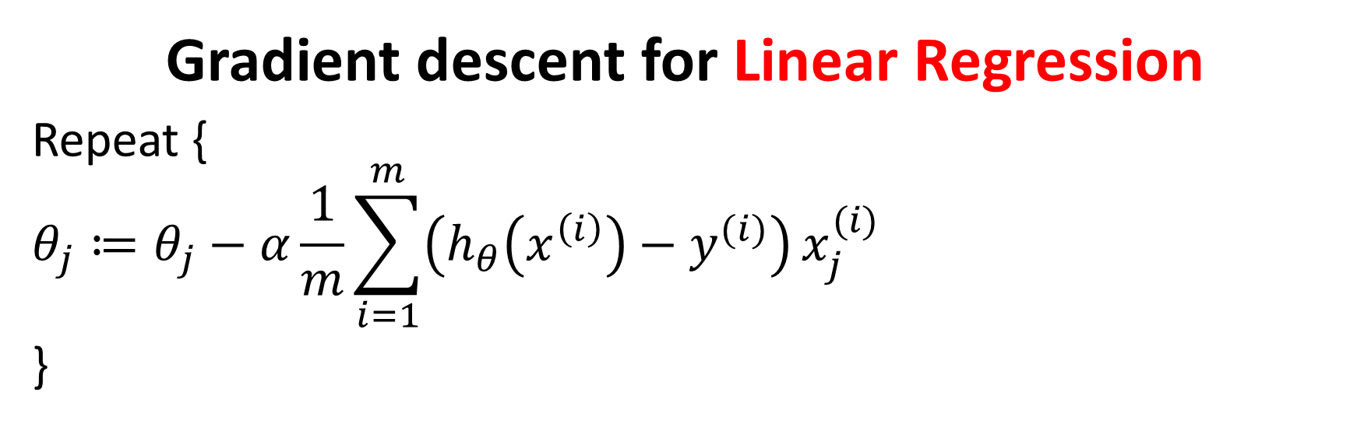
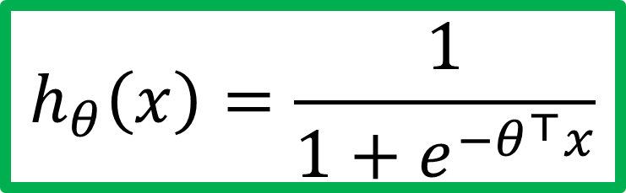

Gradient descent for Linear Regression
Repeat {
$$θ_{j}≔θ_{j}−α\frac{1}{m}\sum_{i=1}^{m}{\left(h_{θ}\left(x^{\left(i\right)}\right)−y^{(i)}\right)}x_{j}^{(i)}$$
}
$$h_{θ}\left(x\right)=θ^{⊤}x$$
Gradient descent for Logistic Regression
Repeat {
$$θ_{j}≔θ_{j}−α\frac{1}{m}\sum_{i=1}^{m}{\left(h_{θ}\left(x^{\left(i\right)}\right)−y^{(i)}\right)}x_{j}^{(i)}$$
}
$$h_{θ}\left(x\right)=\frac{1}{1+e^{−θ^{⊤}x}}$$

Slide 26
Logistic Regression
Hypothesis representation
Cost function
Logistic regression with gradient descent
Regularization
Multi-class classification

Slide 27


How about MAP?
Maximum conditional likelihood estimate (MCLE)
Maximum conditional a posterior estimate (MCAP)
$θ_{MCLE}=\underset{θ}{argmax}$ $\prod_{i=1}^{m}{P_{θ}\left(y^{(i)}|x^{\left(i\right)}\right)}$
$θ_{MCAP}=\underset{θ}{argmax}$ $\prod_{i=1}^{m}{P_{θ}\left(y^{(i)}|x^{\left(i\right)}\right)P(θ)}$

Slide 28
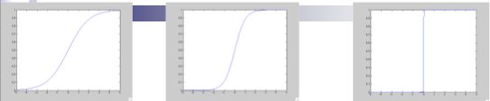
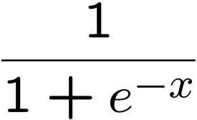
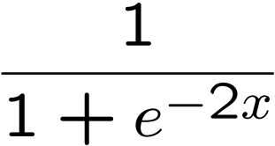
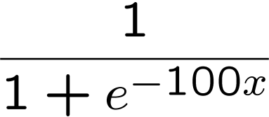
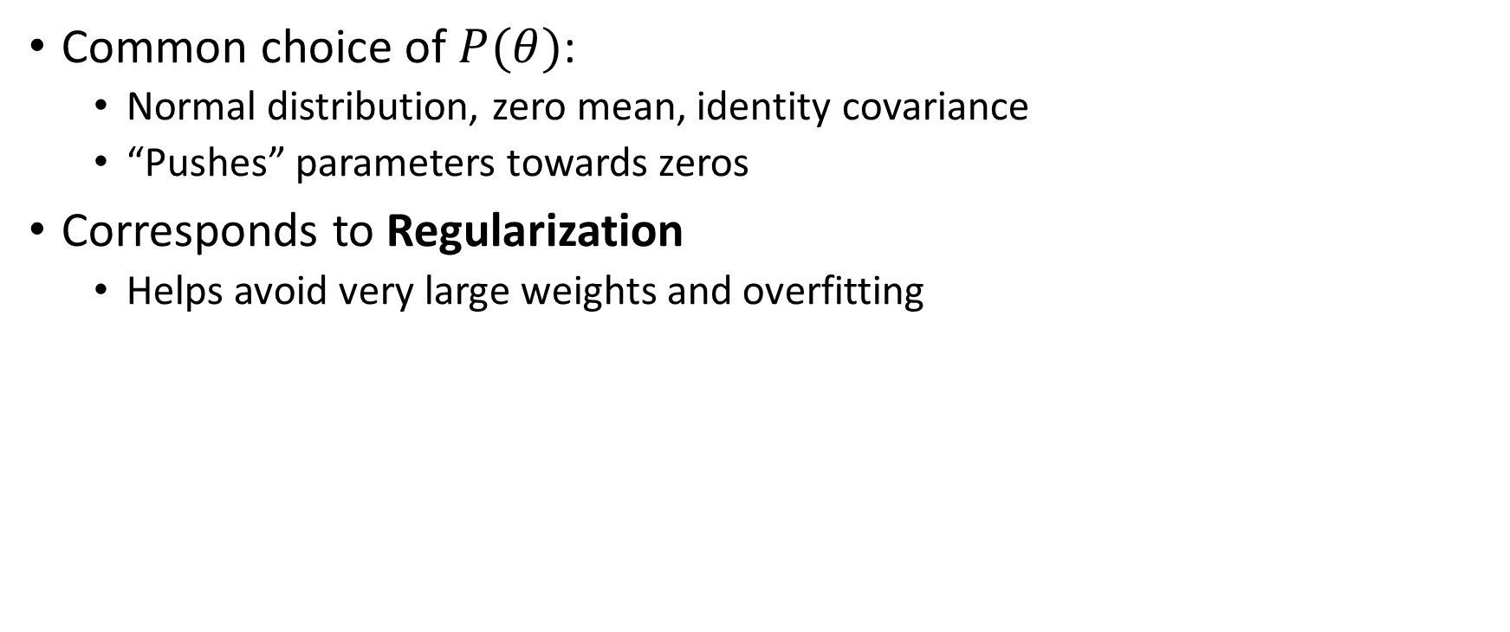

Prior $P(θ)$
Common choice of $P(θ)$:
Normal distribution, zero mean, identity covariance
“Pushes” parameters towards zeros
Corresponds to Regularization
Helps avoid very large weights and overfitting

Slide 29
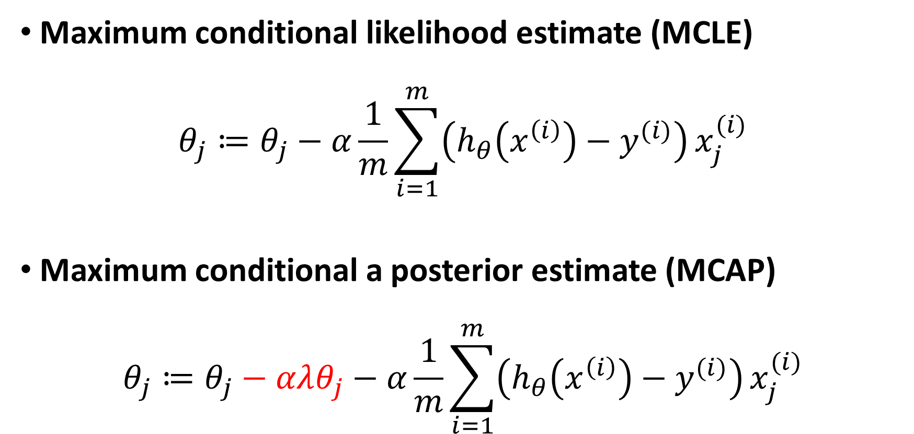
MLE vs. MAP
Maximum conditional likelihood estimate (MCLE)
$$θ_{j}≔θ_{j}−α\frac{1}{m}\sum_{i=1}^{m}{\left(h_{θ}\left(x^{\left(i\right)}\right)−y^{(i)}\right)}x_{j}^{(i)}$$
Maximum conditional a posterior estimate (MCAP)
$$θ_{j}≔θ_{j}−αλθ_{j}−α\frac{1}{m}\sum_{i=1}^{m}{\left(h_{θ}\left(x^{\left(i\right)}\right)−y^{(i)}\right)}x_{j}^{(i)}$$

Slide 30
Logistic Regression
Hypothesis representation
Cost function
Logistic regression with gradient descent
Regularization
Multi-class classification

Slide 31
Multi-class classification
Email foldering/taggning: Work, Friends, Family, Hobby
Medical diagrams: Not ill, Cold, Flu
Weather: Sunny, Cloudy, Rain, Snow

Slide 32




Binary classification
Multiclass classification
$$x_{2}$$
$$x_{2}$$
$$x_{1}$$
$$x_{1}$$

Slide 33










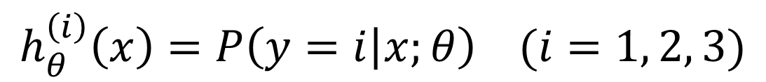

One-vs-all (one-vs-rest)
$$x_{2}$$
$$h_{θ}^{\left(1\right)}\left(x\right)$$
$$x_{1}$$
$$x_{2}$$
$$x_{2}$$
$$h_{θ}^{\left(2\right)}\left(x\right)$$
$$x_{1}$$
$$x_{1}$$
Class 1:
Class 2:
Class 3:
$$h_{θ}^{\left(3\right)}\left(x\right)$$
$$x_{2}$$
$$h_{θ}^{\left(i\right)}\left(x\right)=P\left(y=i | x;θ\right) (i=1, 2, 3)$$
$$x_{1}$$

Slide 34
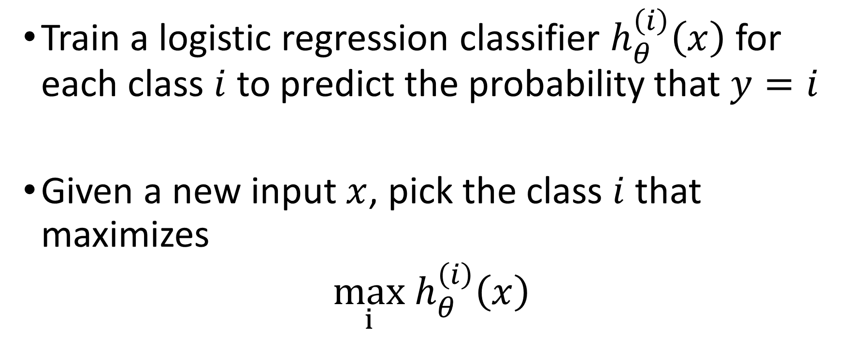
One-vs-all
Train a logistic regression classifier $h_{θ}^{\left(i\right)}\left(x\right)$ for each class $i$ to predict the probability that $y=i$
Given a new input $x$, pick the class $i$that maximizes
$\max_{i}$ $h_{θ}^{\left(i\right)}\left(x\right)$

Slide 35
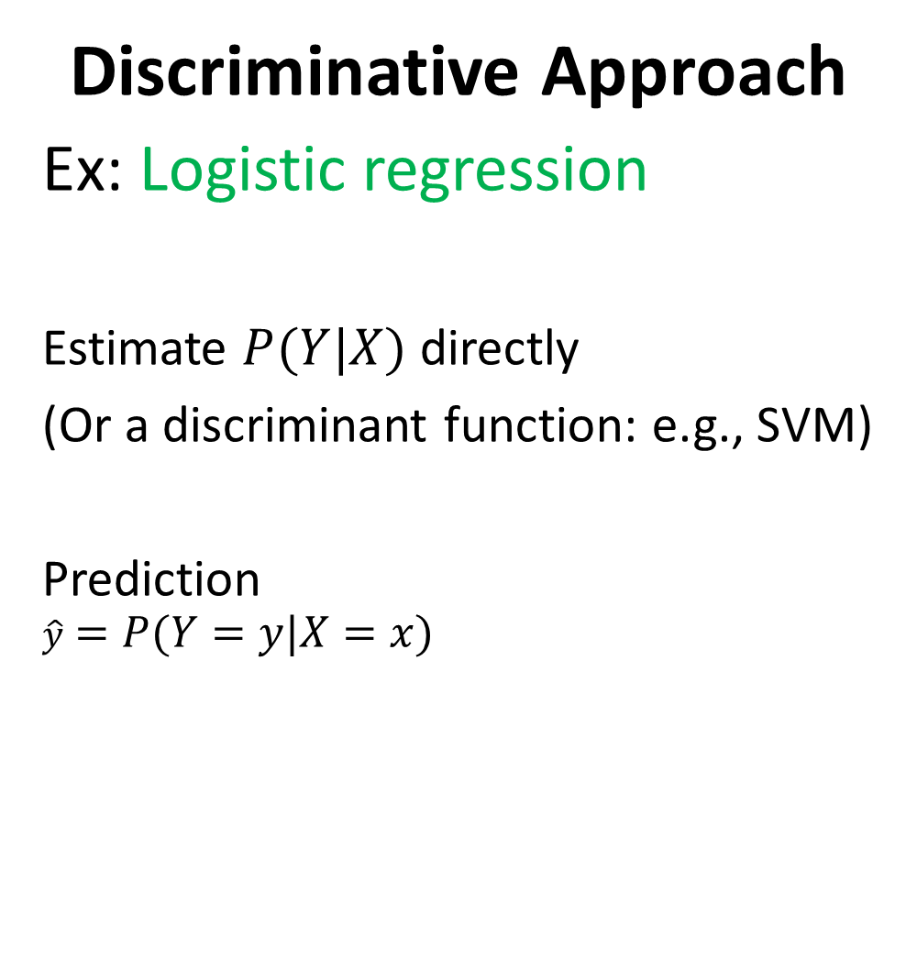
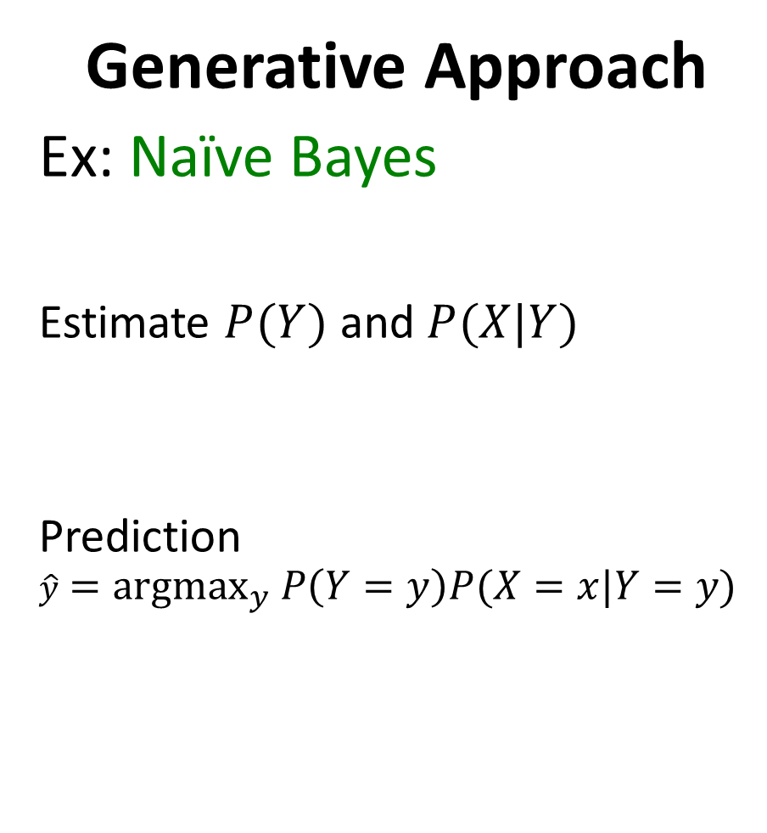
Generative Approach
Ex: Naïve Bayes
Estimate $P(Y)$ and $P(X|Y)$
Prediction
$$\hat{y}={argmax}_{y} P\left(Y=y\right)P(X=x|Y=y)$$
Discriminative Approach
Ex: Logistic regression
Estimate $P(Y|X)$ directly
(Or a discriminant function: e.g., SVM)
Prediction
$$\hat{y}=P(Y=y|X=x)$$

Slide 36
Further readings
Tom M. Mitchell Generative and discriminative classifiers: Naïve Bayes and Logistic Regression http://www.cs.cmu.edu/~tom/mlbook/NBayesLogReg.pdf
Andrew Ng, Michael Jordan On discriminative vs. generative classifiers: A comparison of logistic regression and naive bayes http://papers.nips.cc/paper/2020-on-discriminative-vs-generative-classifiers-a-comparison-of-logistic-regression-and-naive-bayes.pdf

Slide 37
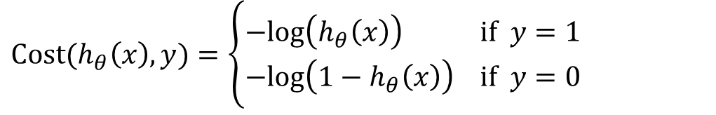
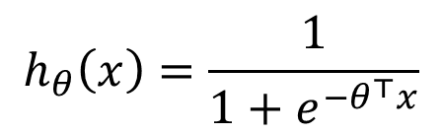
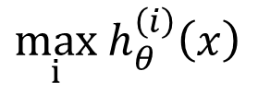
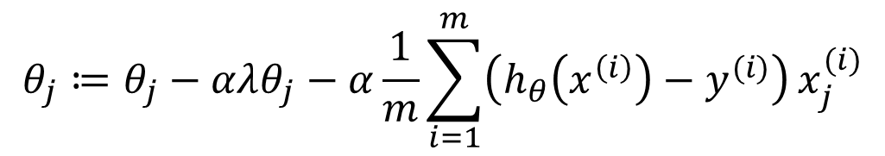

Things to remember
$$h_{θ}\left(x\right)=\frac{1}{1+e^{−θ^{⊤}x}}$$
Hypothesis representation
Cost function
Logistic regression with gradient descent
Regularization
Multi-class classification
$$Cost(h_{θ}\left(x\right),y)=\left\{\begin{aligned}−log\left(h_{θ}\left(x\right)\right) if y=1 \\ −log\left({1−h}_{θ}\left(x\right)\right) if y=0\end{aligned}\right.$$
$$θ_{j}≔θ_{j}−α\frac{1}{m}\sum_{i=1}^{m}{\left(h_{θ}\left(x^{\left(i\right)}\right)−y^{(i)}\right)}x_{j}^{(i)}$$
$$θ_{j}≔θ_{j}−αλθ_{j}−α\frac{1}{m}\sum_{i=1}^{m}{\left(h_{θ}\left(x^{\left(i\right)}\right)−y^{(i)}\right)}x_{j}^{(i)}$$
$\max_{i}$ $h_{θ}^{\left(i\right)}\left(x\right)$

Slide 38

Coming up…
Regularization
Support Vector Machine

